Slide 1
Accounting for Merchandising Firms - Accounting Principles
2022. 3.
Dr. Yangin Yoon

Slide 2
Recap the last class
Financial Statements:
- Statement of Financial Position
(Balance Sheet, B/S)
- Statement of Comprehensive Income
(Profit and Loss statement, P/L, P&L)
- Statement of Changes in Equity
- Statement of Cash Flows
- Notes

Slide 3
Recap the last class
Rules:
- Natural law
- Man-made rules
Accounting rules (GAAP, Generally Accepted Accounting Principles)
- IFRS, K-IFRS, K-GAAP, etc.
- Let’s find some:
https://www.google.com/
(http://www.kasb.or.kr/fe/accstd/NR_list.do?sortCd=K-IFRS&divCd=01)
(https://www.ifrs.org/issued-standards/list-of-standards/)

Slide 4
Any Questions?

Slide 5

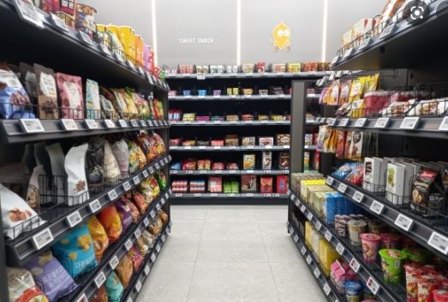
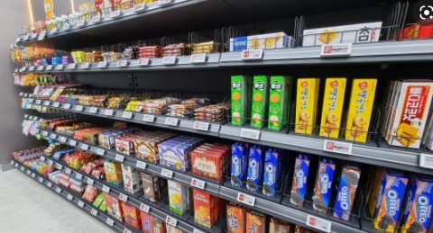
Accounting for Merchandising Firms
Merchandising Firms:
- Buying goods and selling goods

Slide 6
Accounting for Merchandising Firms
When they buy goods:
When they sell all the goods:
→ What if they sell just half of the goods?
What if they bought goods multiple times?
Inventory $5,000
Cash $5,000
Cash $8,000
Revenue $8,000
Cost of goods $5,000
Inventory $5,000

Slide 7
Accounting for Merchandising Firms
The ABC OIL started its business on 20X2. 1.10.
This is a gasoline station, and it sells only one type of gasoline.
It has bought gasolines from its suppliers.
20X1. 2. 1. the shop sold 350 liters. How much is the cost of goods?
20X1. 2. 26. the shop sold 600 liters. How much is the cost of goods?
Date | Amounts (liters) | Unit price ($/liter) | Total Value
20X2. 1. 15. | 100 | 20 | 2,000
20X2. 1. 25. | 300 | 15 | 4,500
20X2. 2. 20. | 500 | 18 | 9,000
20X2. 3. 25. | 400 | 16 | 6,400

Slide 8
Inventory Cost Assumptions
First-in, first out (FIFO)
- First purchase amount is the first cost assigned to cost of goods sold
- Ending inventory is based on the latest purchase amounts
Last-in, first-out (LIFO)
- Costing is the opposite of FIFO
- Last purchase amount goes immediately to cost of goods sold
- Ending inventory is based on the oldest purchase amount
Weighted-Average Cost
- Based on the average unit amount of inventory during the period

Slide 9
First-in, first out (FIFO)
The ABC OIL started its business on 20X2. 1.10.
This is a gasoline station, and it sells only one type of gasoline.
It has bought gasoline from its suppliers.
20X1. 2. 1. the shop sold 350 liters. How much is the cost of goods?
100 * 20
+ 250 * 15 = 2000 + 3750 = 5,750
20X1. 3. 26. the shop sold 600 liters. How much is the cost of goods?
50 * 15
+ 500*18
+ 50 *16 = 750 + 9000 + 800 = 10050
Date | Amounts (liters) | Unit price ($/liter) | Total Value
20X2. 1. 15. | 100 | 20 | 2,000
20X2. 1. 25. | 300 | 15 | 4,500
20X2. 2. 20. | 500 | 18 | 9,000
20X2. 3. 25. | 400 | 16 | 6,400

Slide 10
First-in, first out (FIFO)
The ABC OIL started its business on 20X2. 1.10.
This is a gasoline station, and it sells only one type of gasoline.
It has bought gasoline from its suppliers.
20X1. 2. 1. the shop sold 350 liters. How much is the cost of goods?
20X1. 3. 26. the shop sold 600 liters. How much is the cost of goods?
Date | Amounts (liters) | Unit price ($/liter) | Total Value
20X2. 1. 15. | 100 | 20 | 2,000
20X2. 1. 25. | 300 | 15 | 4,500
20X2. 2. 20. | 500 | 18 | 9,000
20X2. 3. 25. | 400 | 16 | 6,400
Cash XXX
Revenue XXXX
Cost of goods 5,750
Inventory 5,750
Cash XXX
Revenue XXXX
Cost of goods 10,050
Inventory 10,050

Slide 11
Last-in, first-out (LIFO)
The ABC OIL started its business on 20X2. 1.10.
This is a gasoline station, and it sells only one type of gasoline.
It has bought gasoline from its suppliers.
20X1. 2. 1. the shop sold 350 liters. How much is the cost of goods?
50 * 20
+ 300 * 15 = 1000 + 4500 = 5,500
20X1. 3. 26. the shop sold 600 liters. How much is the cost of goods?
200*18
+ 400 *16 = 3600 +6400 = 10,000
Date | Amounts (liters) | Unit price ($/liter) | Total Value
20X2. 1. 15. | 100 | 20 | 2,000
20X2. 1. 25. | 300 | 15 | 4,500
20X2. 2. 20. | 500 | 18 | 9,000
20X2. 3. 25. | 400 | 16 | 6,400
or 350*16 = 5,600
or 50*16 + 500*18
+ 50*15 = 10,550

Slide 12
Last-in, first-out (LIFO)
The ABC OIL started its business on 20X2. 1.10.
This is a gasoline station, and it sells only one type of gasoline.
It has bought gasoline from its suppliers.
20X1. 2. 1. the shop sold 350 liters. How much is the cost of goods?
20X1. 3. 26. the shop sold 600 liters. How much is the cost of goods?
Date | Amounts (liters) | Unit price ($/liter) | Total Value
20X2. 1. 15. | 100 | 20 | 2,000
20X2. 1. 25. | 300 | 15 | 4,500
20X2. 2. 20. | 500 | 18 | 9,000
20X2. 3. 25. | 400 | 16 | 6,400
Cash XXX
Revenue XXXX
Cost of goods 5,500
Inventory 5,500
Cash XXX
Revenue XXXX
Cost of goods 10,000
Inventory 10,000

Slide 13
Weighted-Average Cost
The ABC OIL started its business on 20X2. 1.10.
This is a gasoline station, and it sells only one type of gasoline.
It has bought gasoline from its suppliers.
20X1. 2. 1. the shop sold 350 liters. How much is the cost of goods?
[ ( 100 * 20 + 300 * 15) / 400 ] * 250 = 16.25 * 250 = 5,687.5
20X1. 3. 26. the shop sold 600 liters. How much is the cost of goods?
[ 16.25 * (100+300-350) + 500* 18 + 400 * 16 ] / (50+500+400) * 600
= 16212.5 / 950 * 600 = 10239.47
Date | Amounts (liters) | Unit price ($/liter) | Total Value
20X2. 1. 15. | 100 | 20 | 2,000
20X2. 1. 25. | 300 | 15 | 4,500
20X2. 2. 20. | 500 | 18 | 9,000
20X2. 3. 25. | 400 | 16 | 6,400

Slide 14
Weighted-Average Cost
The ABC OIL started its business on 20X2. 1.10.
This is a gasoline station, and it sells only one type of gasoline.
It has bought gasoline from its suppliers.
20X1. 2. 1. the shop sold 350 liters. How much is the cost of goods?
20X1. 3. 26. the shop sold 600 liters. How much is the cost of goods?
Date | Amounts (liters) | Unit price ($/liter) | Total Value
20X2. 1. 15. | 100 | 20 | 2,000
20X2. 1. 25. | 300 | 15 | 4,500
20X2. 2. 20. | 500 | 18 | 9,000
20X2. 3. 25. | 400 | 16 | 6,400
Cash XXX
Revenue XXXX
Cost of goods 5,687.5
Inventory 5,687.5
Cash XXX
Revenue XXXX
Cost of goods 10,239.47
Inventory 10,239.47

Slide 15
Cost of goods vs. Inventory Balance
The ABC OIL started its business on 20X2. 1.10.
This is a gasoline station, and it sells only one type of gasoline.
It has bought gasoline from its suppliers.
Total 46,000
20X1. 2. 25. the shop sold 200 liters. How much is the cost of goods?
- The unit price is increasing rapidly.
How much is the cost of goods?
4,000 or 14,000 or other?
How much is the inventory balance at the end of February?
42,000 or 32,000 or other?
Date | Amounts (liters) | Unit price ($/liter) | Total Value
20X2. 1. 15. | 100 | 20 | 2,000
20X2. 1. 25. | 300 | 30 | 9,000
20X2. 2. 20. | 500 | 70 | 35,000

Slide 16
Inventory Cost Assumptions
Accounting Rules:
- Man-made rules
Accounting rules (GAAP, Generally Accepted Accounting Principles)
- IFRS, K-IFRS, K-GAAP, etc.
- Let’s find some (Is LIFO method allowed in IFRS?):
https://www.google.com/
(http://www.kasb.or.kr/fe/accstd/NR_list.do?sortCd=K-IFRS&divCd=01)
(https://www.ifrs.org/issued-standards/list-of-standards/)

Slide 17
Accounting for Merchandising Firms
Now, you can make journal entries for a merchandising company.
You can prepare the financial statements for a merchandising company.
- Statement of Financial Position
- Statement of Comprehensive Income
- Statement of Changes in Equity
- Statement of Cash Flows
- Notes

Slide 18
Any Questions?

